Slide 1
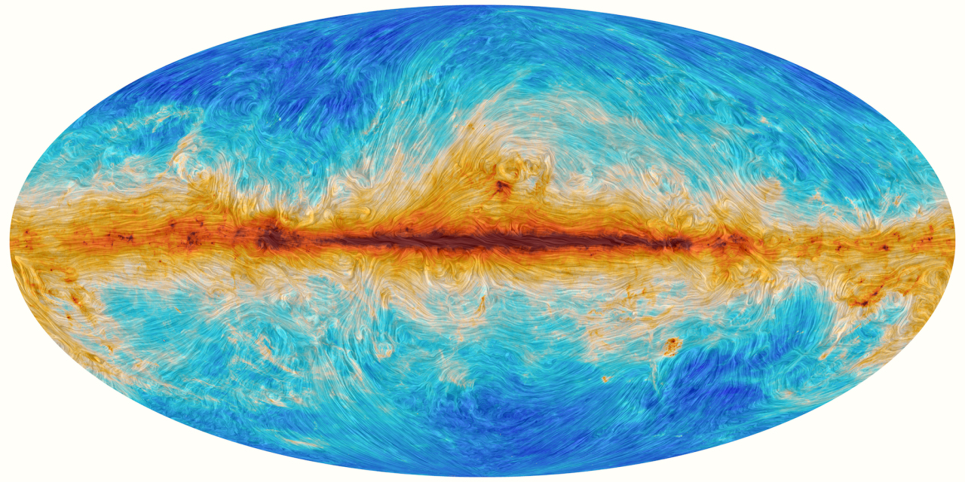
A New Turbulence Measure from Multi-frequency Synchrotron Polarization
Recover the turbulence spectrum and anisotropy from polarization maps without RM synthesis.
We introduce a directional-spectrum measure computed directly from Q and U.
Aliaksandr Melnichenka
Berea College
American Astronomical Society (AAS 247)
January 7, 2026
Phoenix, AZ.
Alex Lazarian (UW Madison)
Dmitry Pogosyan (University of Alberta)
Notes:
Names, conference name
“Imagine recovering the spectrum of interstellar magnetic turbulence from just one polarization map at one radio frequency. No RM synthesis. No wide bandwidth. That’s the core result of our work.”

Slide 2
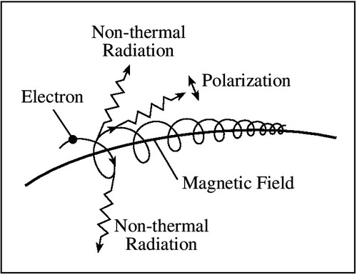
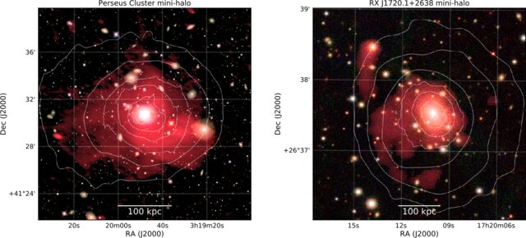
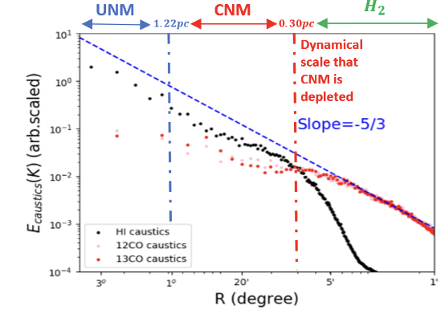
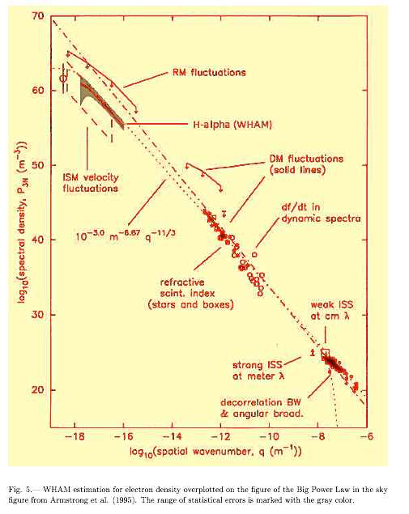
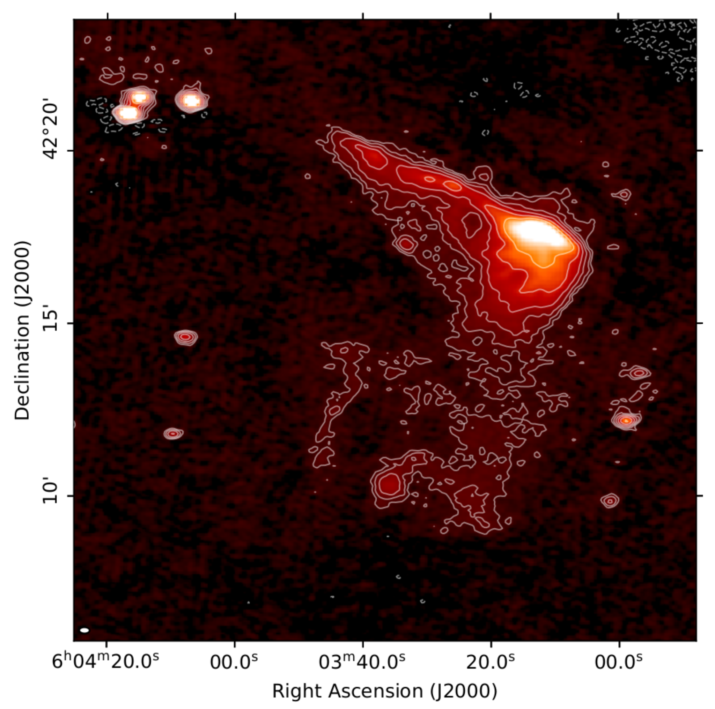
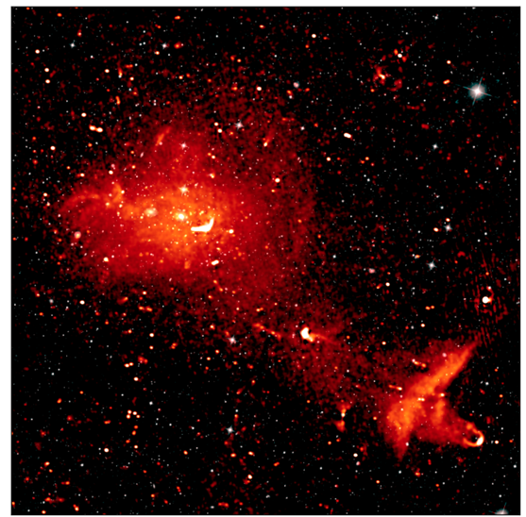
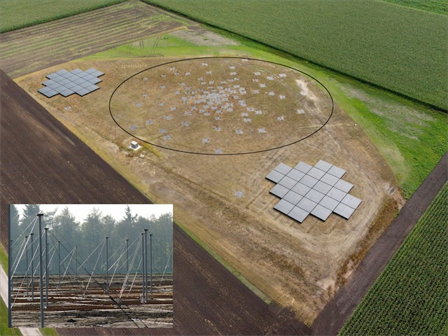
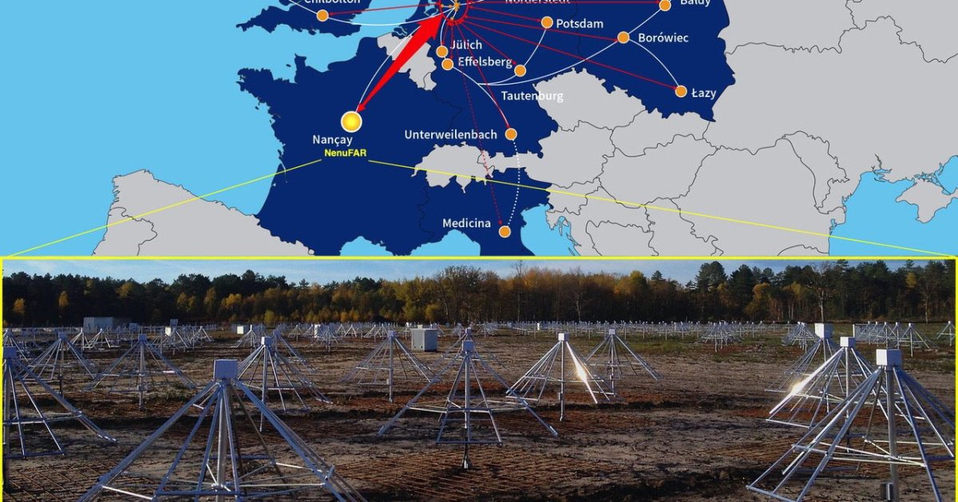
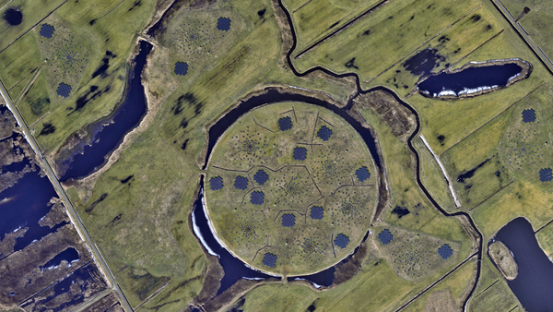
Why turbulence? Why polarization maps?
Interstellar Medium
Typical magnetic field tracing method: synchrotron polarization
Velocity fluctuations
van Weeren et al. (2019)
Density fluctuations
Taurus region
Synchrotron emission
Wittor Denis (2023)
Bonafede et al. (2022)
420 pc
140pc
46.7pc
11.7pc
2.3pc
New radio surveys
Kolmogorov spectrum
Distance (degrees,pc)
LOFAR
large sky coverage,
many wavelengths
Yuen, Ho & AL 2021
Armstrong+ 95;
Chepurnov & AL 09
Kolmogorov spectrum is common in Astrophysics
(star formation, transport, cosmic rays, heating)
Notes:
Turbulence is important in many directions.
It’s important to study the cosmic rays, the accelerations, for star formation.
For all of this is important, because all liquids in astrophysics are turbulent. And turbulence changes all of their properties.
Synchrotron polarization traces magnetic turbulence across scales

Slide 3
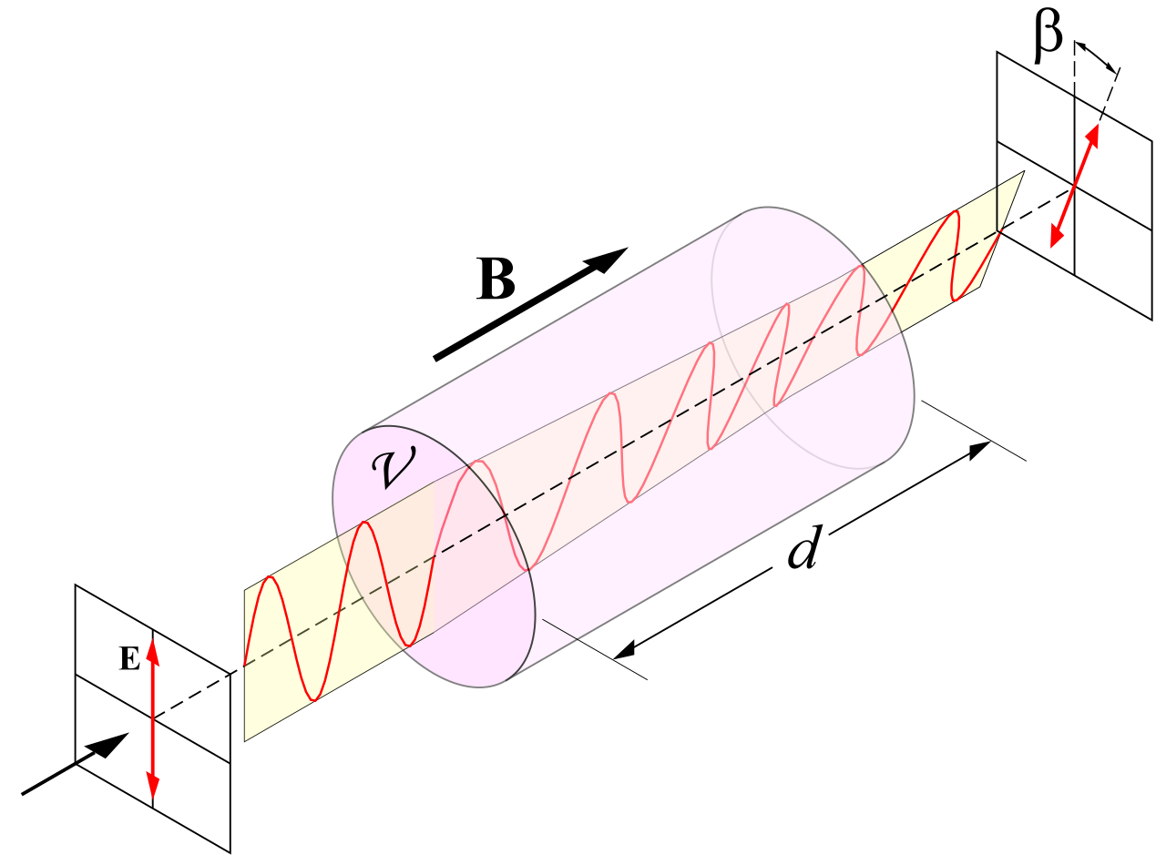

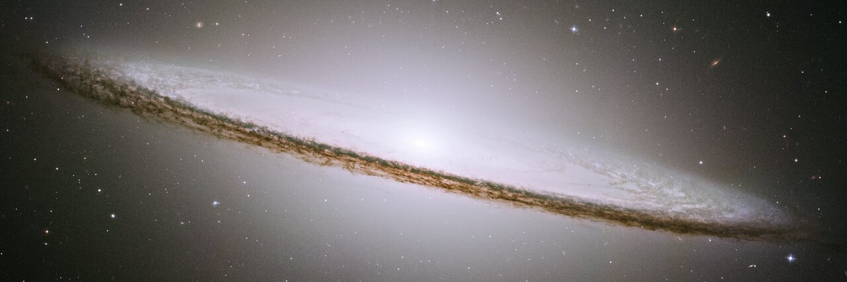
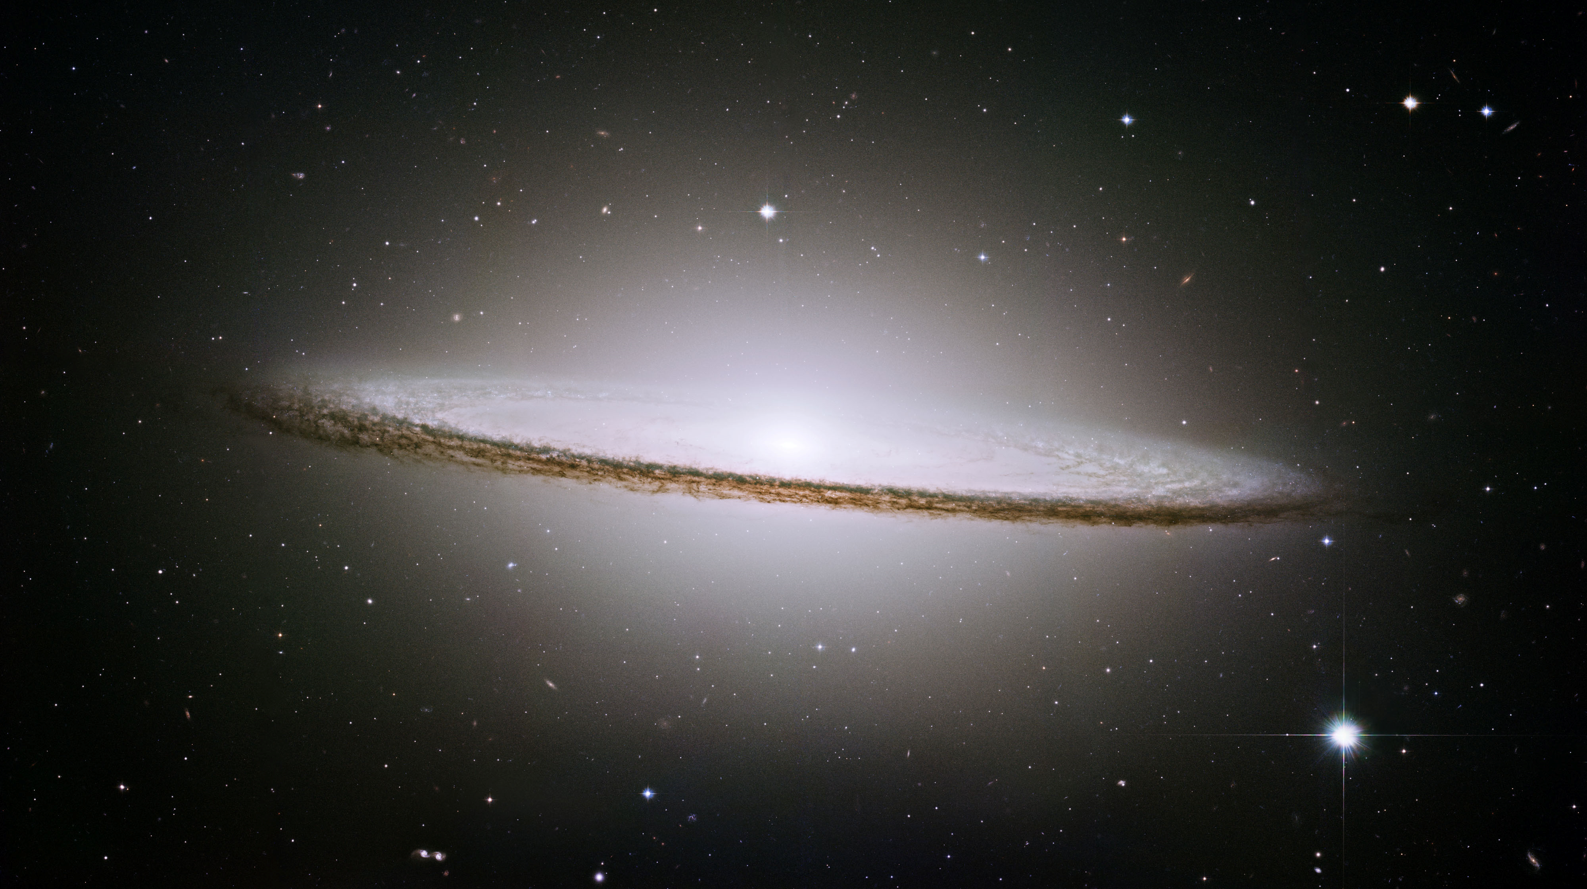
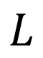
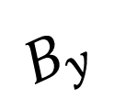
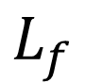
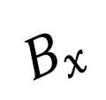
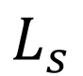
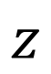
The core problem: intrinsic vs Faraday are mixed
Two sources of fluctuations: (i) intrinsic synchrotron polarization
(ii) Faraday rotation
$$B_{y}$$
$$L_{f}$$
$$B_{x}$$
$$L_{s}$$
observer
LOS
Separated Screens Geometry
$$L$$
Faraday emitting screen
(galaxy disk, ionized part of more dense gas that dominates faraday rotation)
$$z$$
Intrinsic synchrotron screen
(galactic halo; outer parts of the galaxy
where the thermal electron density is low)
Notes:
It is important to distinguish: there is one spectr, and there is another. And studying them separately is important. But when we start to measure, some measures are mixed. Because, of this it is important to emphasize them and separate.
So we suggest a new method of separation. So observers could distinguish what is faraday and what is intristic. And we could estimate the transitional range, and regime, when two effects are mixed.
And the presence of more than one measure allows to more accurately study the separation, and determine what is what.

Slide 4
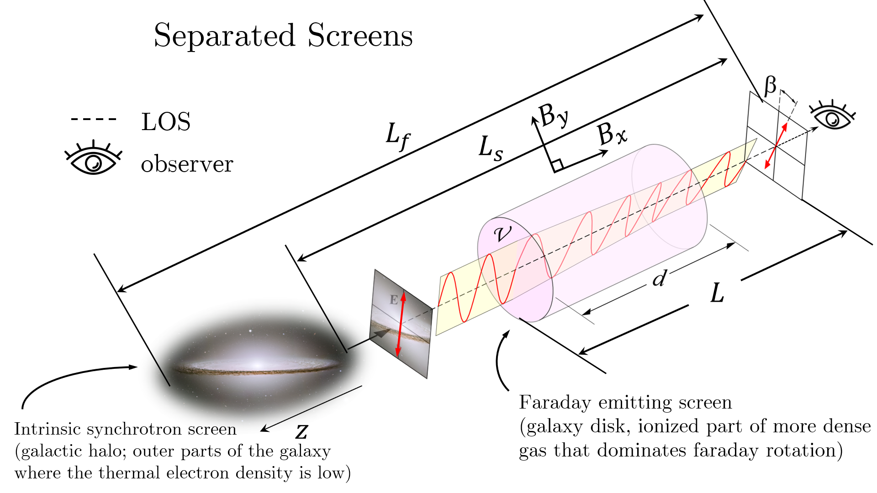
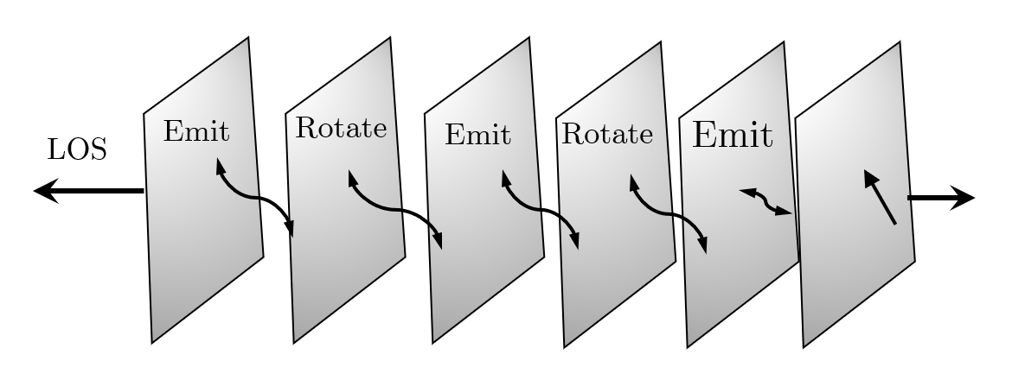
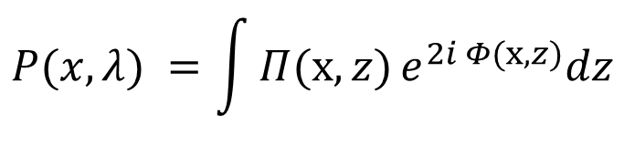
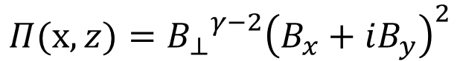

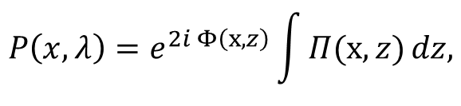
Propagation geometries: separated screen and mixed volume
$$Π(x,z)={{B_{⊥}}^{γ−2}\left(B_{x}+iB_{y}\right)}^{2}$$
With emissivity ($γ=2$):
Separated screen
(external RM screen in front of emitter)
Mixed volume
(emission and rotation in the same region)
$$P\left(x, λ\right)=e^{2i Φ\left(x,z\right)}\int{Π(x,z)}dz,$$
$$P(x, λ) =\int{Π(x,z)}e^{2i Φ(x,z)}dz$$
Notes:
Separated screens are common: halo emission + disk RM screen, or background source + foreground ionized layer
It is important to distinguish: there is one spectr, and there is another. And studying them separately is important. But when we start to measure, some measures are mixed. Because, of this it is important to emphasize them and separate.
So we suggest a new method of separation. So observers could distinguish what is faraday and what is intristic. And we could estimate the transitional range, and regime, when two effects are mixed.
And the presence of more than one measure allows to more accurately study the separation, and determine what is what.

Slide 5
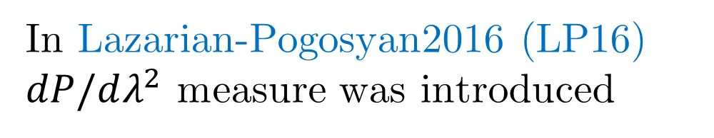
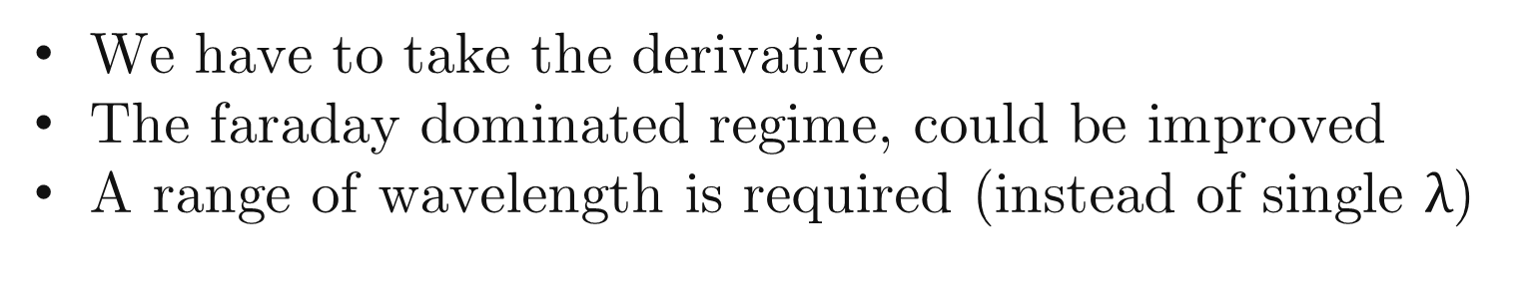
Common diagnostic approaches to Study Turbulence
Scattering (e.g. scintillation, pulse broadening)
Spectral statistics(power spectra, structure functions)
Gradient-based methods…
Haverkorn et al. (2006) changed the wavelength
BUT because wavenumber coverage grows slowly with wavelength, large bandwidths are required to measure turbulence spectra.
In Lazarian-Pogosyan2016 (LP16)
$dP/dλ^{2}$ measure was introduced
BUT
We have to take the derivative
The faraday dominated regime, could be improved
A range of wavelength is required (instead of single $λ$)
Notes:
title
Planck, sections
Next slide: Faraday, path alternatives
Synchrton as good measure of magnetic field
informant
Magnetic turbulence is ubiquitous in astrophysics
(Armstrong et al. 1995). It shapes star formation (Fed-
errath 2016), angular momentum transport (Balbus &
Hawley 1991), and mediates conductivity and cosmic-
ray propagation (Brandenburg & Lazarian 2013), yet
most observational diagnostics are limited to 2D pro-
jections along the line of sight (LOS) (Elmegreen &
Scalo 2004). Faraday rotation is one of the most widely
used probes of these magnetized plasmas: from Galac-
tic RM grids and pulsars to cluster radio halos and FRBs, it reveals the LOS magnetic field weighted by
the thermal-electron density, and—through its spatial
statistics—encodes the underlying turbulence (e.g., see
the review by Akahori et al. 2018).

Slide 6
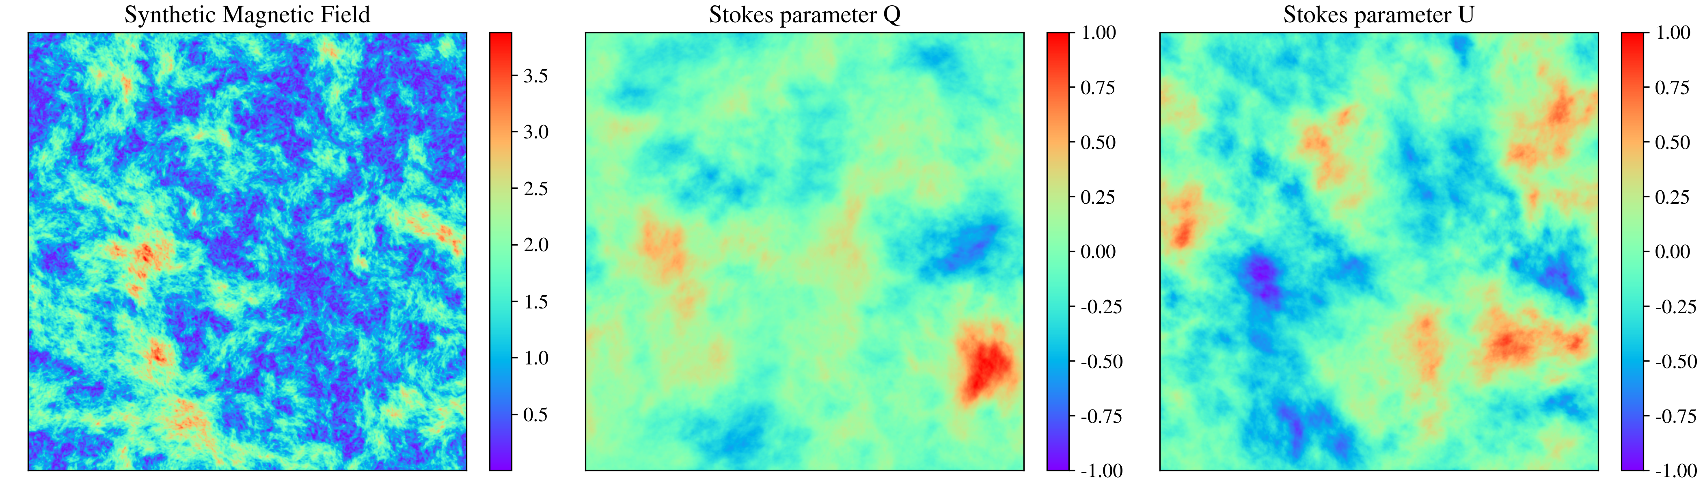
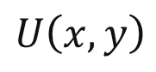
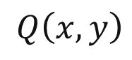
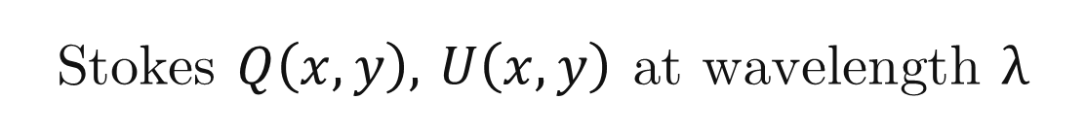
New Measure: Directional Spectrum of $P$
Stokes $Q\left(x,y\right),$ $U\left(x,y\right)$ at wavelength $λ$
Directional spectrum
(2D Fourier power vs direction)
$Q\left(x,y\right)$
$U\left(x,y\right)$
$$P\left(X,λ\right)=Q+iU, D\left(k,λ\right)=\left\langle |\tilde{P}(k,λ)|\right\rangle$$
Practical advantages:
no angle unwrapping
no derivative required
maps directly to spectrum
$$P_{dir}\left(k\right)={|FFT(cos(2χ)|}^{2}+{|FFT(sin(2χ)|}^{2}$$
*where $χ−$polarization angle fluctuations
Notes:
On the other hand, we propose a measure, that doesn’t require the derivative.
It could be occurred directly from Q and U stokes parameters, that are available directly from the observations.

Slide 7
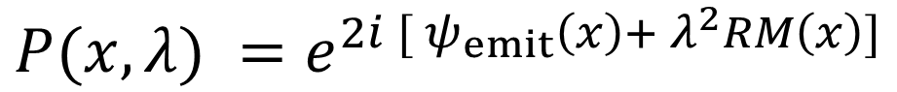
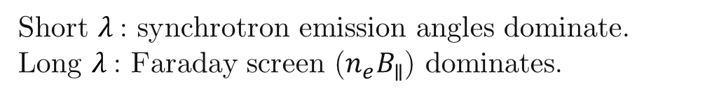
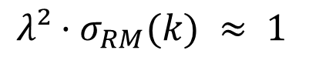
Emission vs. Faraday Screen: who dominates?
Polarization model (external screen):
$$P(x, λ) =e^{2i [ ψ_{emit}\left(x\right)+ λ^{2}RM\left(x\right)]}$$
Transition criterion (at scale k):
$$λ²·σ_{RM}(k) ≈ 1$$
defines crossover $k_{×} (λ)$
Short $λ$: synchrotron emission angles dominate.
Long $λ$: Faraday screen ($n_{e}B_{∥}$) dominates.
Standard Deviation of Rotation Measure
Notes:
1. Initiallly Draw the picture halo, thickness, and so on on the front title 2. here, plot when the dispertion increases (plot the layer, and some вихри) 3. more transition to simulations addres.
“At wavenumber k, the winner is set by a simple rule: when λ² times the RM dispersion at k is about one, the dominance flips. We call the corresponding wavenumber k-cross, and we can measure it from a single map. As λ increases, k-cross slides to smaller k, revealing a clean, predictable transition from synchrotron-dominated to Faraday-dominated structure.”

Slide 8
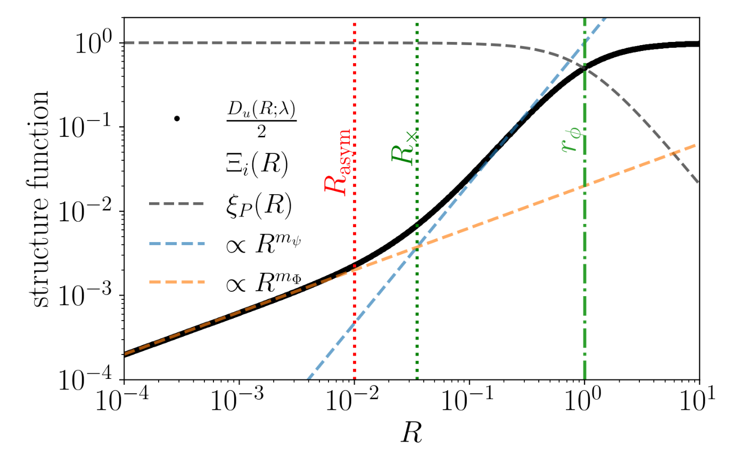
Which regime dominates (instrinstic, faraday, or transitional)?

Slide 9
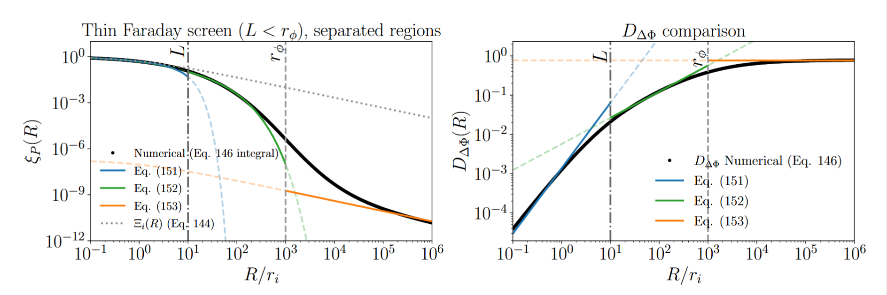
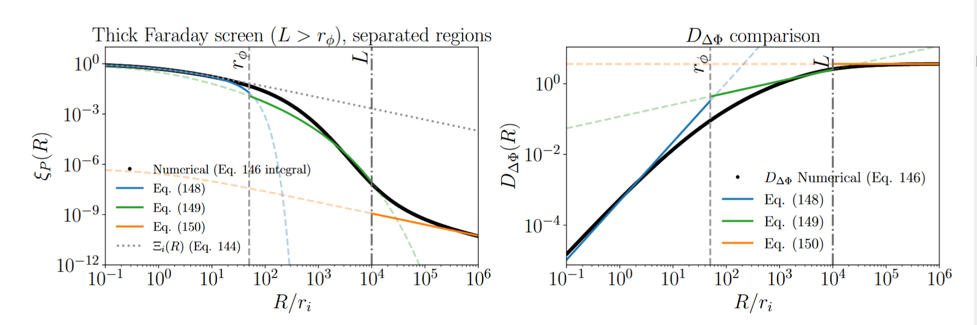

Slide 10
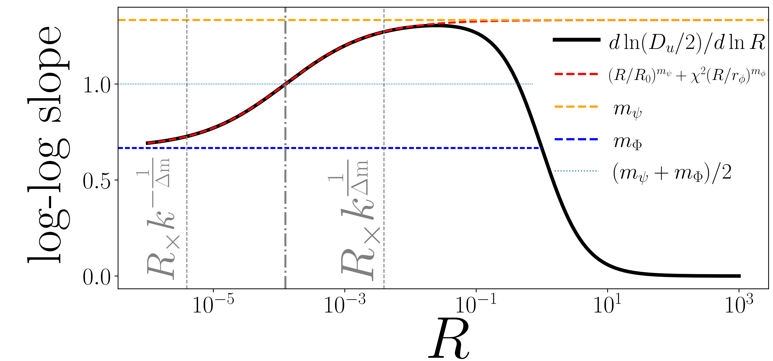
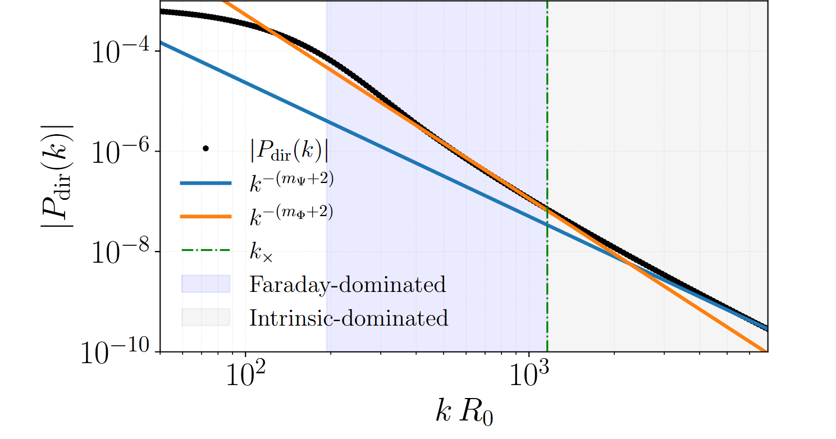
Which regime dominates (instrinstic, faraday, or transitional)?

Slide 11
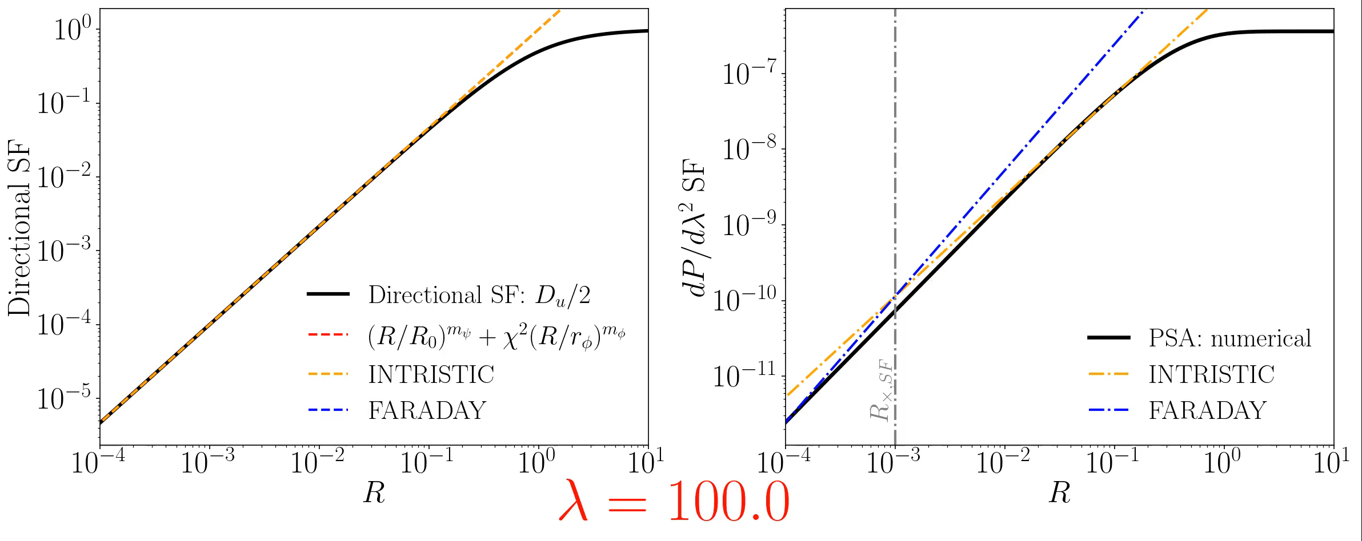
Comparison Directional and $dP/dλ^{2}$ structure functions
New Directional measure shows better correlation for faraday screen!

Slide 12
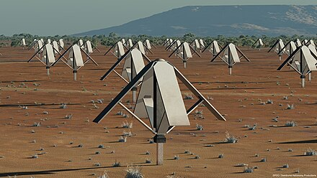
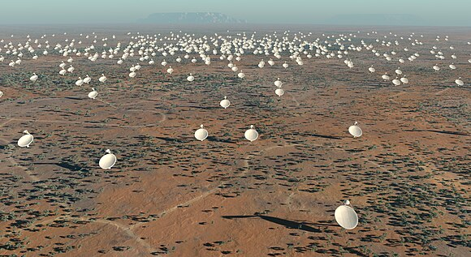

SKA
Directional Spectrum Measure Advantages
New information about Faraday
The new measure is new and progressive
Not need to compute derivatives
Use one wavelength only (instead array)
LOFAR
Two measures are complementary. Intrinsic fluctuations can be measured by studying non-polarized synchrotron radiation, while spatial fluctuations reveal information about the synchrotron screen.

Slide 13
A New Turbulence Measure from Multi-frequency Synchrotron Polarization
Recover the turbulence spectrum and anisotropy from polarization maps without RM synthesis.
We introduce a directional-spectrum measure computed directly from Q and U.
Aliaksandr Melnichenka
Berea College
American Astronomical Society (AAS 247)
January 7, 2026
Phoenix, AZ.
Alex Lazarian (UW Madison)
Dmitry Pogosyan (University of Alberta)
Notes:
Names, conference name
“Imagine recovering the spectrum of interstellar magnetic turbulence from just one polarization map at one radio frequency. No RM synthesis. No wide bandwidth. That’s the core result of our work.”

